Slide 1
Unified Data and Field Management
April 2023

Slide 2
Unified Data + Field Management
What we need to get there (Components)
Event Management Platform/Front End Tool for collecting manual information
Accessible via mobile
Momentum controlled users and permissions
Customizable fields encompassing all events
Built in reminders and schedule for missing fields/recaps for past events
Calendar view
API data pipeline
Momentum owned and developed Cloud Database for storage and sandbox (VZDB1 Azure DB)
Direct Data Pipeline development with ALL VZ Experiential Data Sources:
Master Calendar/Schedule of Events and Event Details
Common Backend
QR Tiger
Qualtrics (Survey)
Verizon Adobe Analytics Files
BA/BL/FM Collected manual on-site information
SOP/System of Processes and cadence for Data Governance, Auditing, and regular maintenance and QA
Schedule for data source updates

Slide 3
Verizon x MOMO Organizational Data System​
Portfolio-wide standardized system for:
Booking and planning “events”
Managing Event Details, Changes, Updates, and Assets/Items required for events
Collecting on-site information through a cloud platform/web-based tool (updatable by anyone with access from anywhere, and version control – not 10 different sheets with the same and possibly conflicting manually collected information)
Verizon Experiential Intelligence Dashboard as the source of truth for measurement of all Momentum Verizon created experiences
Automated processes and data ingestion
Real-time Dashboard/Data accessible by non-analytic business users

Slide 4
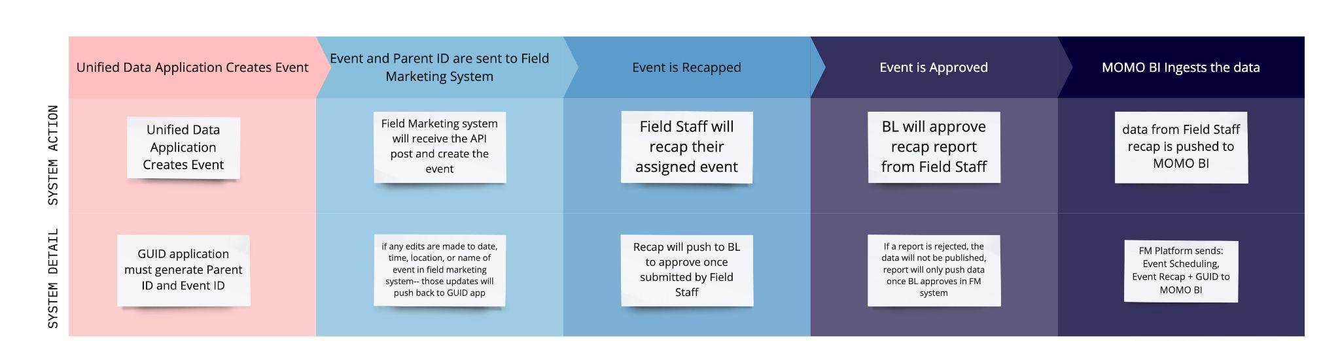
Unified Data + Field Management

Slide 5
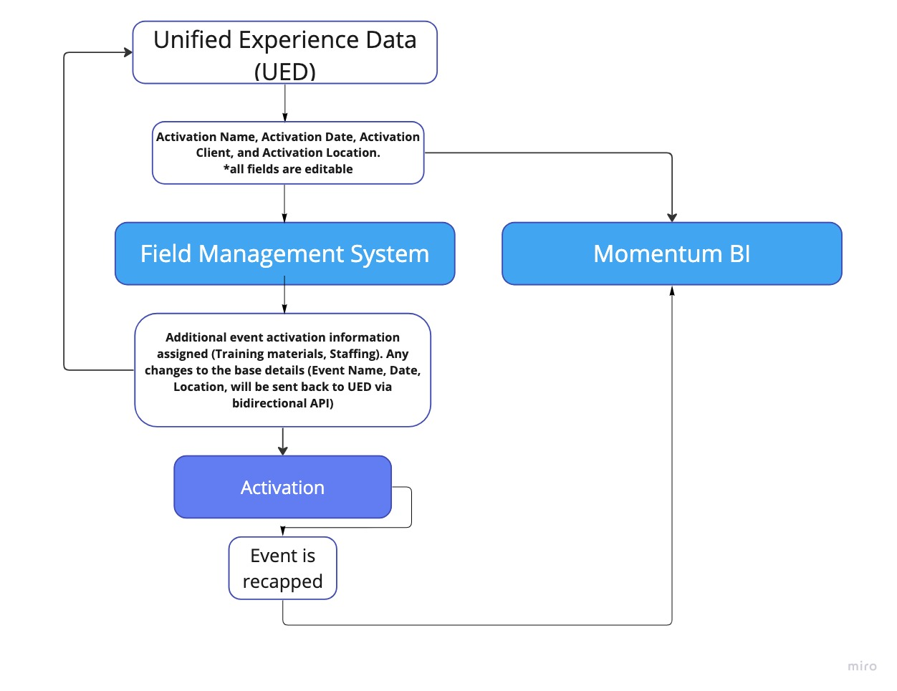
Unified Data + Field Management

Slide 6
Recapping Platform Features
Out of the 8 platforms compared– these are the top 3 that meet the requirements of both Verizon and overall Momentum needs.
Features | Recapping Platform
 | Brandscopic | Pinata | Network Ninja
Dashboard View | ✔️ | ❌ | ✔️
Calendar | ✔️ | ❌ | ✔️
Bi Directional API | ✔️ | ❌ | ❌
Staffing Agency Integration | ❌ | ✔️ | ❌
Attachments for Event | ✔️ | ✔️ | ❌
Offline Data Entry | ✔️ | ✔️ | ❌
Media Upload and Tagging | ✔️ | ✔️ | ✔️
SMS Event Reminders | ✔️ | ✔️ | ❌
Recap Notifications | ✔️ | ✔️ | ❌
Review Recap Reports prior to submitting | ✔️ | ✔️ | ✔️

Slide 7
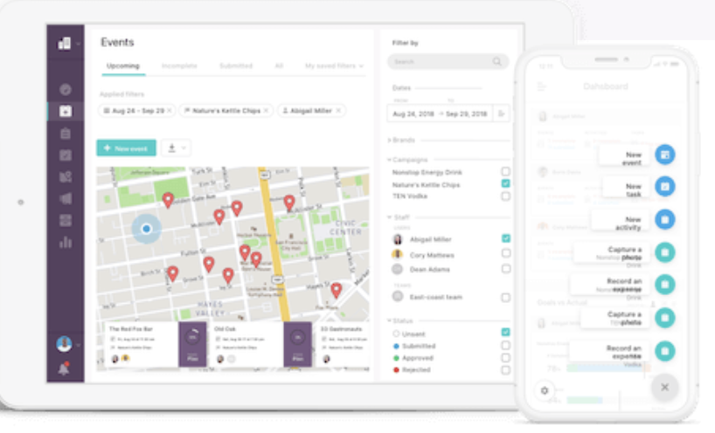
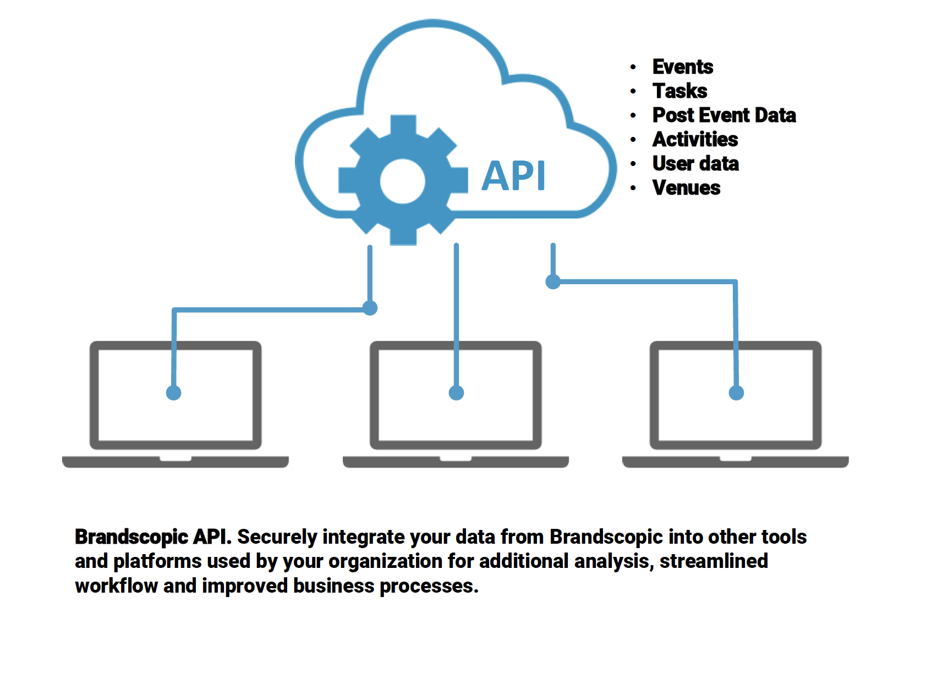
Brandscopic
Mobile App or Responsive web app
Can custom build according to our need
Configurable dashboard
Notifications, in app, sms or email
Calendar view by event, campaign or phase
Geo locate for BA or FM check in (geolocate crumbs or IP address)
Bi directional API
Staffing agencies can have accounts and then assign staff
Can partition the client portals so that Momentum would have 1 portal but multiple clients; no data overlapping

Slide 8
Unified Data + Field Management
Project Roles and Resources
Tech/IP/CT
Kristen Baum: Project Owner, IP Lead
Steve Sanderson: Data Operations and IPG Data/Security Compliance
Analytics/Data Science
Yeuting Wang: ADS Lead, Measurement Systems Data Integration
Reed Whitcraft/Kate Bixby: Data Pipeline and Integration Development
Kayla Ellerbrock: Measurement Framework/Model Lead, Data Visualization
PM
BL/XP
XXXX: BL Lead
XXXX: XP Lead
YEUTING UPDATE

Slide 9
Unified Data + Field Management
Project Roadmap & LOE
YEUTING UPDATE

Slide 10
Unified Data + Field Management
Budget
Event Management Platform Subscription
Azure Database host possible increase
Man hours for integration and pipeline development

Slide 11
Verizon x Momentum
Organizational Data System
April 2023

Slide 12
Field Staff platforms, expanded

Slide 13
Requirements
Platform must meet the following requirements
SCHEDULING
Schedule an event day or multi day events pre event date, ability to import a bulk upload of events or schedule one off (XP+BL)
Export all booked events for a month or date range (XP+BL)
Events classified by program, market and event type
Events scheduled with a date, location (address), and time attributed to them
Events assigned to a specific user or BA in the system to Recap that event
Staffing Agencies to assign/staff events
RECAPS
BA web app that updates real time, can start recap and edit before submitting
BA login permissions to only recap events that person is assigned to
Recaps should have logic to show specific questions based on answers
Recaps will ask a series of questions about event turn out, upload pictures/videos, etc. Should be able to have recaps specific to programs as we do not ask the same questions across all accounts or client
CLIENT
Client log in to only see events that have been recapped and approved
DATA
Recap data should export via API to Momentum Analytics dashboard (Bi)
All data reported to client comes from Momentum dashboard

Slide 14
Next Steps
BL to confirm budget and job number to contract Brandscopic
Brandscopic to give us a full SOW and contract for legal review
Once contracted, Kristen + Analytics to set up Verizon Programs + present to BL
BL to confirm recap questions per program
Brandscopic + Momo connect to establish API to Momo BI
Review with Bethany
Unified Data Doc + Field Marketing
Working session to define data flow
Project Level
IDs

Slide 15
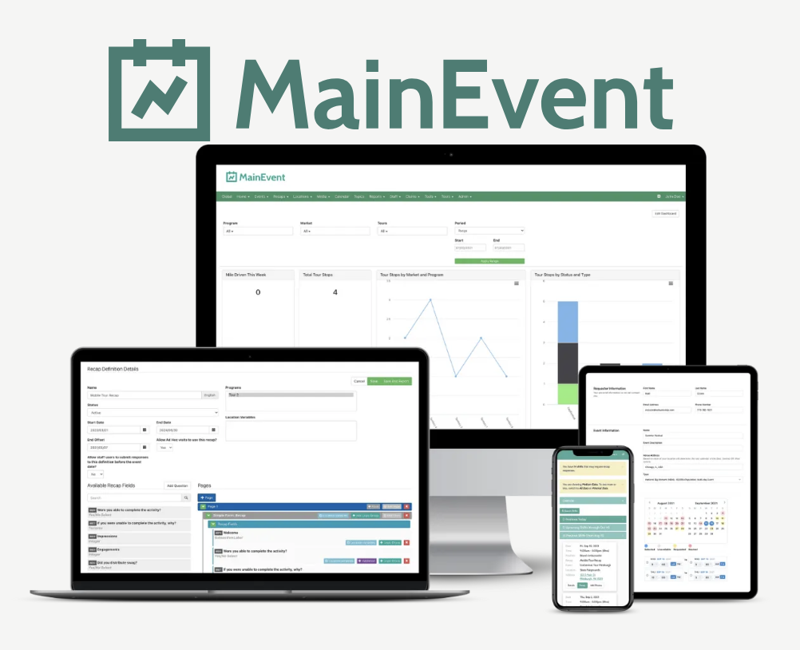
Network Ninja
Functionality has not improved or updated in the last few years
Can easily take an API out to Momentum Analytics dashboard
BA recapping app, able to only see events they are assigned to and recap them
Has a overall calendar but it is not by any means easy to filter or sort
Keeps all of events in a spreadsheet form but often is a long load time once you get more than 300 events
Pricing: 1k per month, 50 users or less, no setup fee
Note: We are using MainEvent for Constellation activation data capture across about 22 markets, for approximately 3K events

Slide 16
Cost Comparison
Highlights:
Brandscopic gives us unlimited users, no matter if they are admin, client, or Field Staff user seats *they do cap at 3k event hours per month (if we had events that were 10 hours long– we’d have 300 events per month)
Pinata will charge $49 / user; so this price will increase as we add users (BL, Analytics, XP, etc)
Network Ninja is certainly the most cost effective, but will come with the least features
breakdown | Brandscopic | Pinata | Network Ninja
/year | $28,800 /year | $30,398/year | $12,000 / year, unlimited tasks and events
/month | $2,400.00 | $1,666.00 | $1,000.00
details | Event Hours per month: 3k | 100 tasks per month | unlimited users and events
users | Unlimited users | 40 users / $49/ USER | Unlimited

Slide 17
Unified Data + Field Management

Slide 18
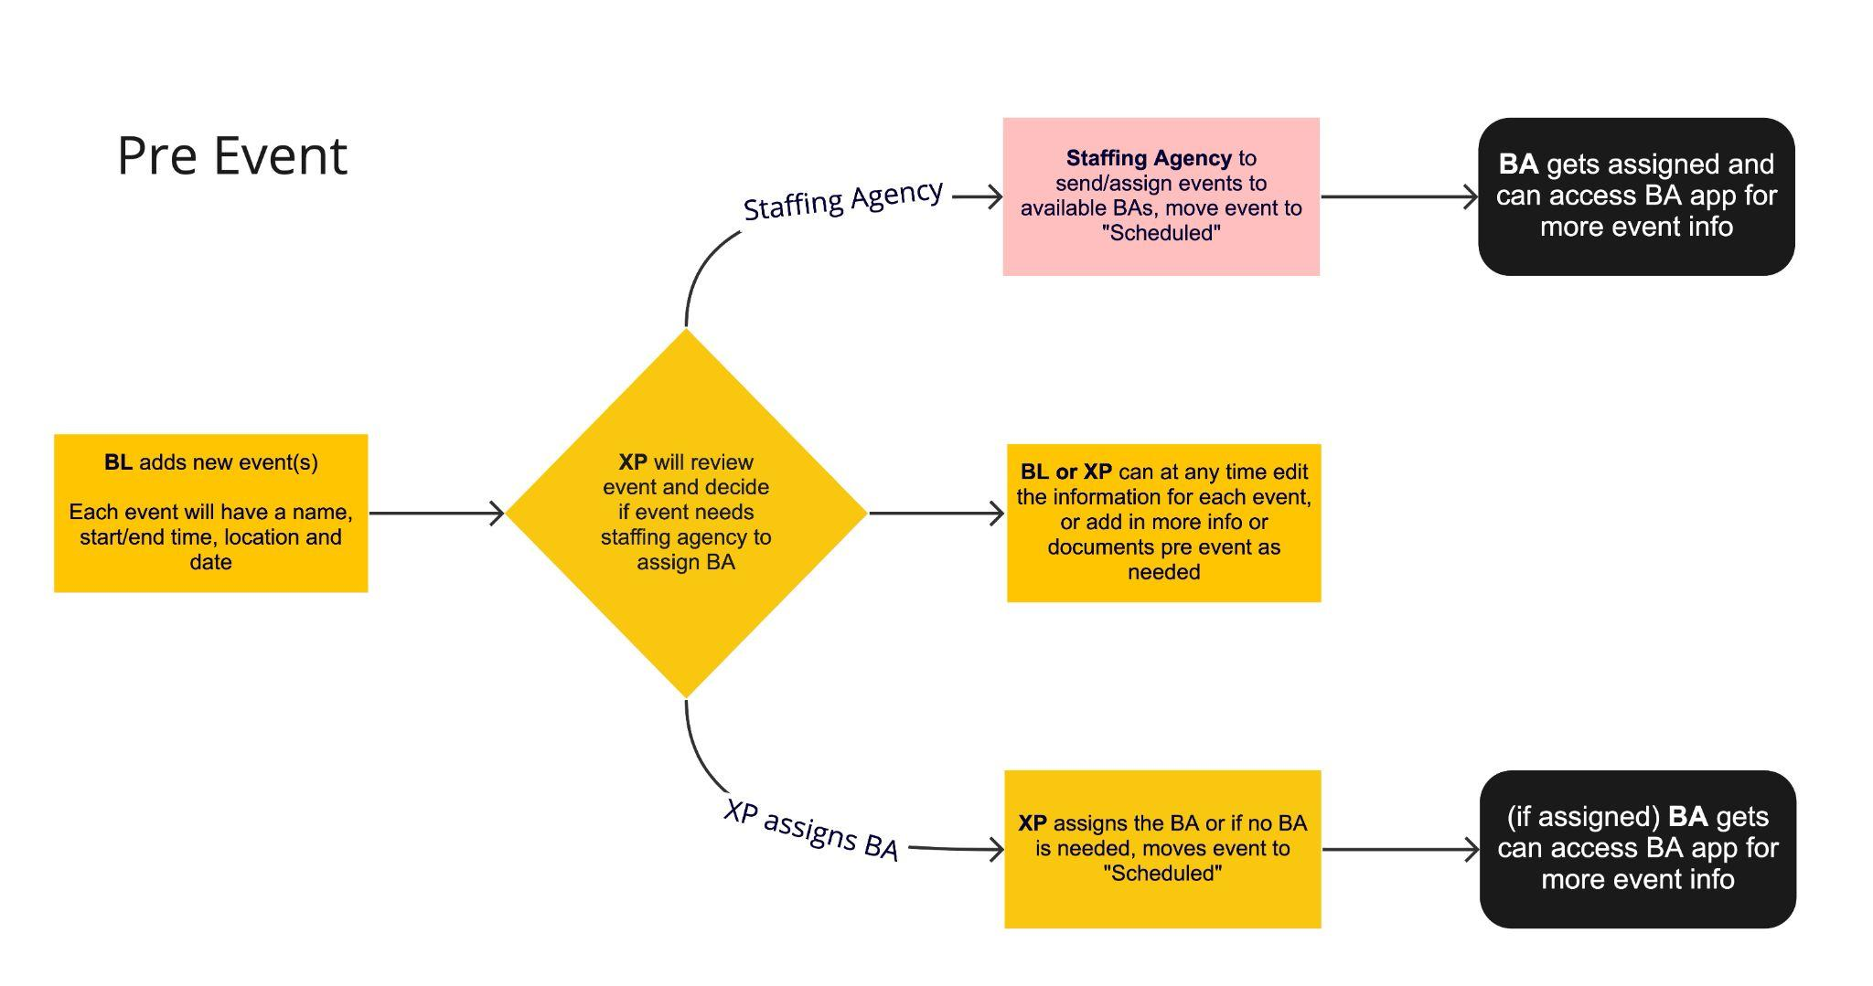
USER JOURNEY, scheduling

Slide 19
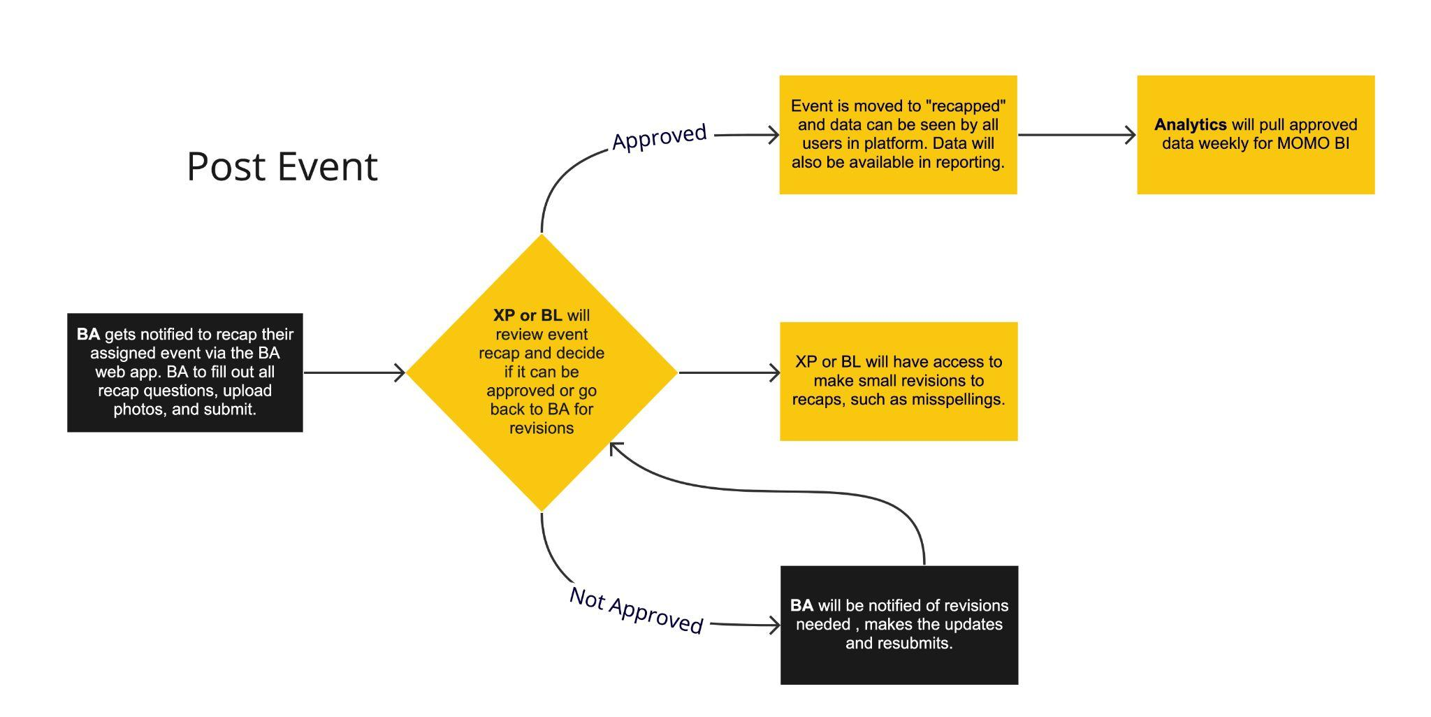
USER JOURNEY, post event

Slide 20
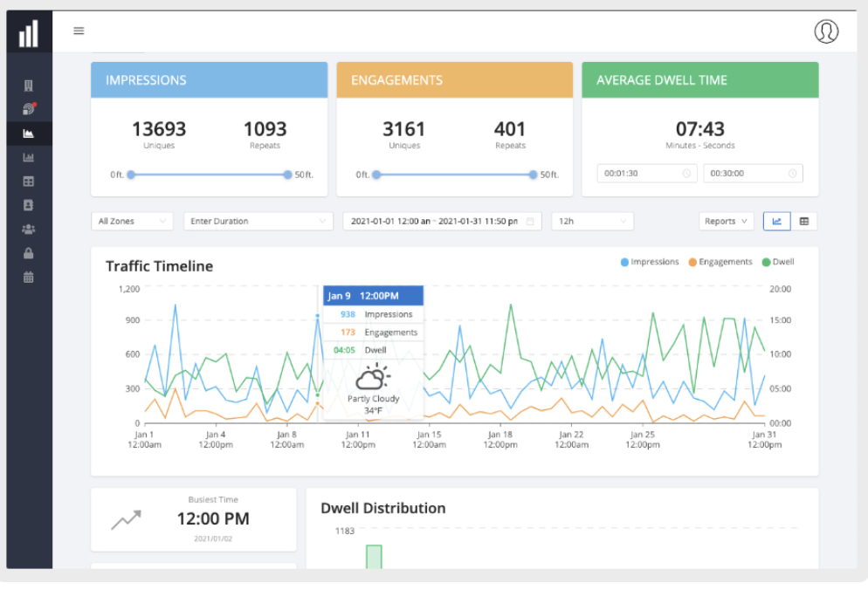
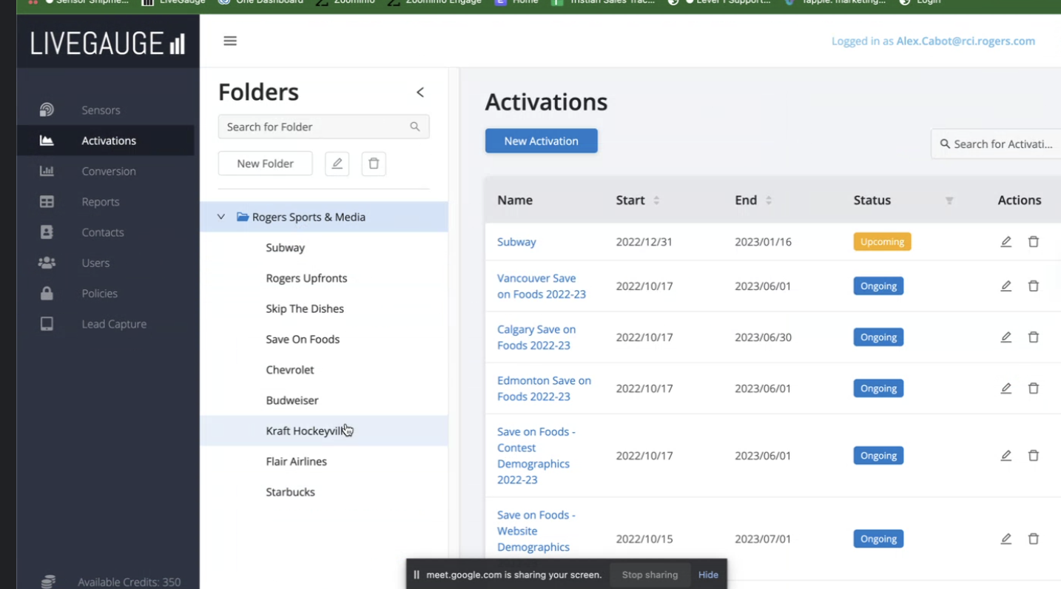
LIVEGAUGE
Reco’d by our Canada MOMO office
Based on location = we get weather data, other event data, and demographic data
Smart qr codes
Logic, data points
Demographic data, can tie these qr codes back to the event they are being used at
They don't have a calendar
Can do an export of events in a timeframe
They do have sensor devices like mesh, which can be tied back to the events as well but those aren’t mandatory to use. Devices can collect data offline.
Link on browser for BA’s to recap, they will only have access to recap/upload photos
Cost is TBD– they are sending a MSA, can do month to month billing

Slide 21
graveyard

Slide 22

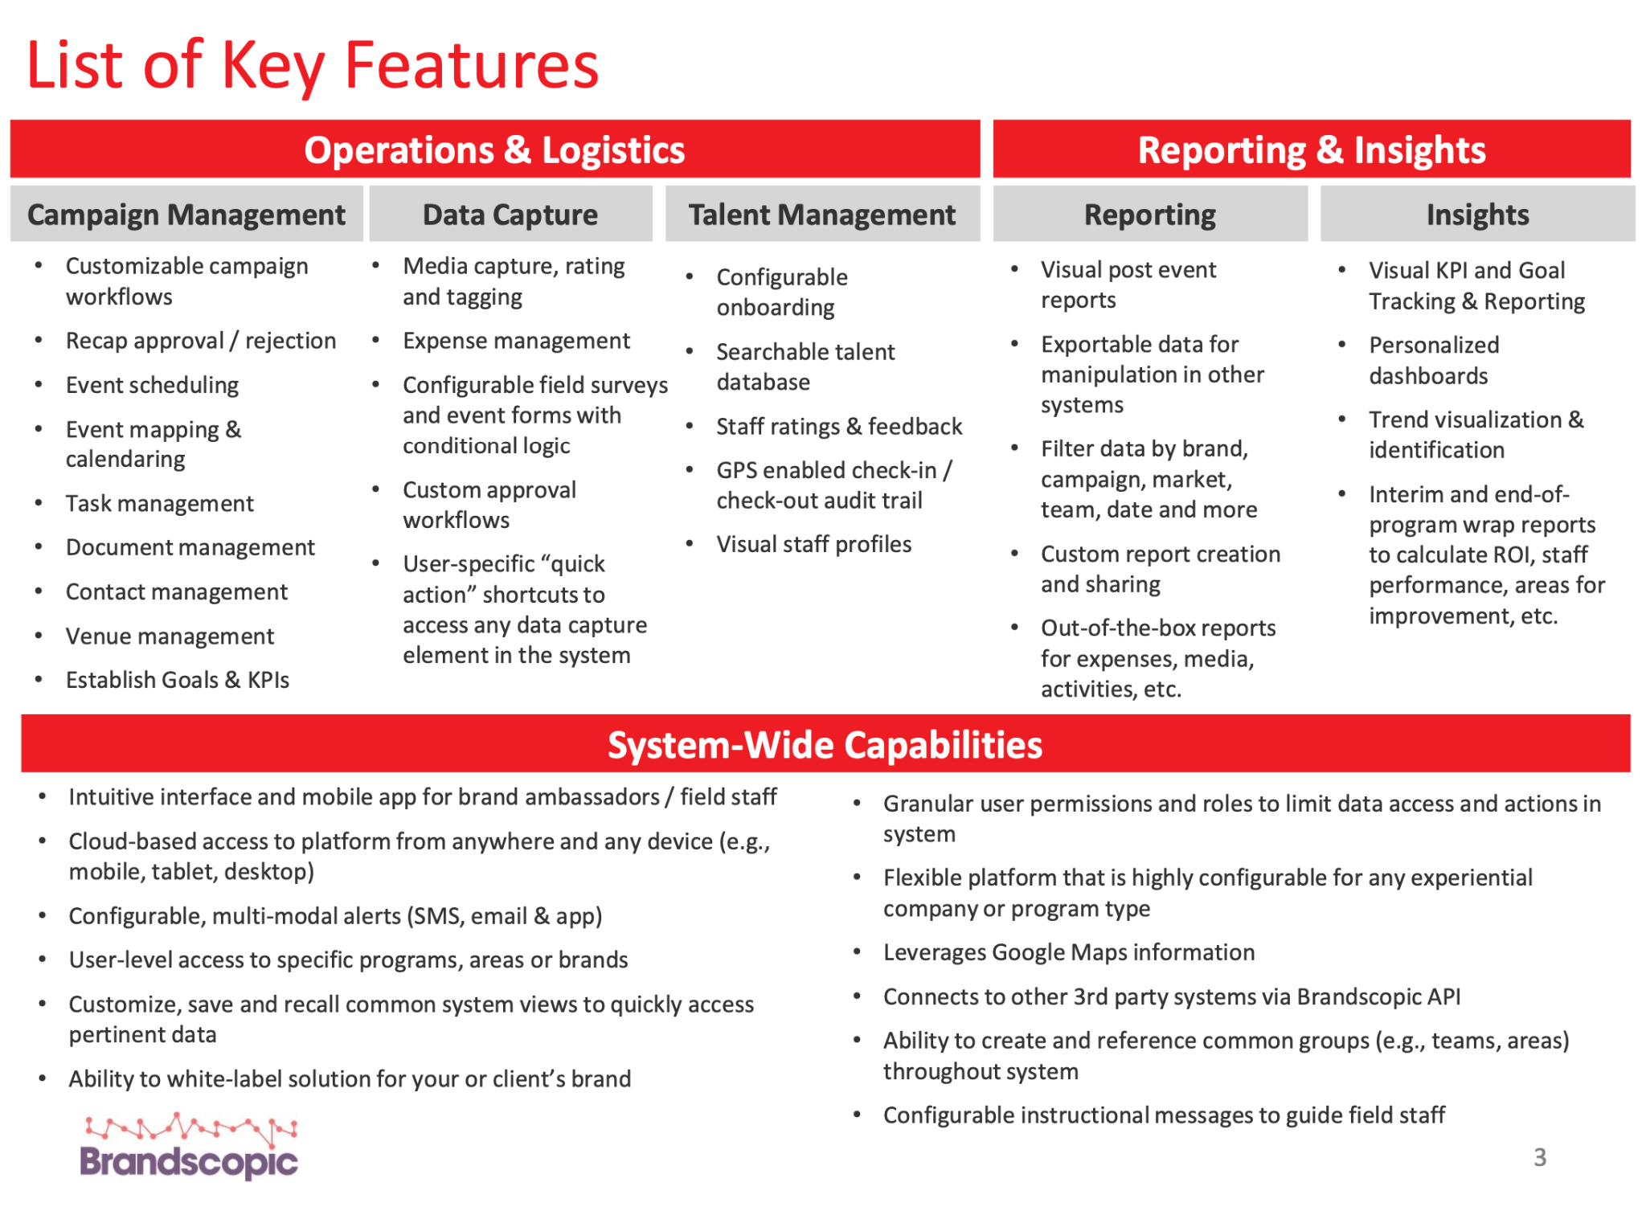
When considering key features, API abilities, and per user cost–Brandscopic is the leading platform.

Slide 23
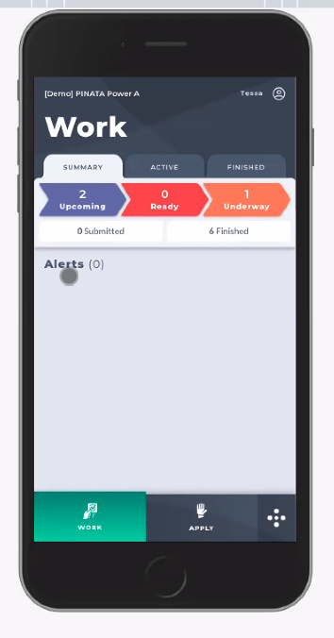
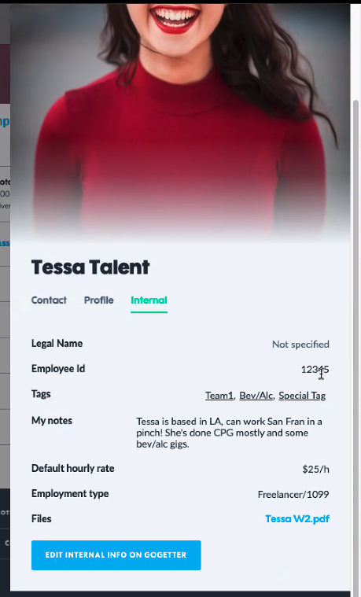
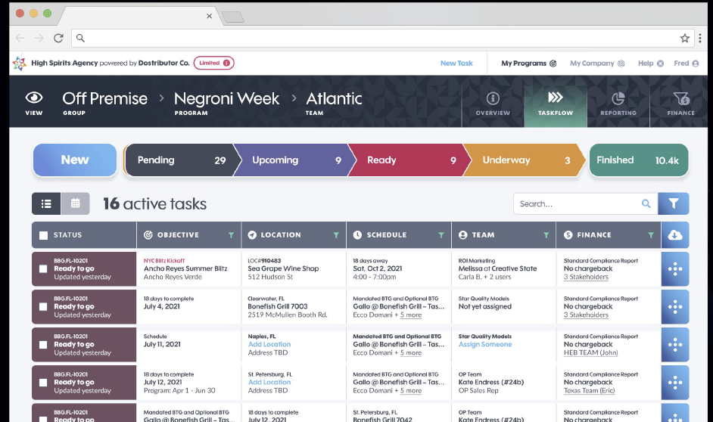
Pinata
PINATA will onboard staffing agencies so that they can assign or request BAs for events
Locations integration w/ google, locations can upload and save easily, can upload maps to get to the actual event space for the BA
Can assign multiple user groups to the events when assigning
BAs create profiles w/ photos, shirt size, email, etc
Can manage $$ profiles and attach it to profile in admin also add tags
BA app is web based
Text 30 min before to “log in”; log in gives all upcoming activity for that BA only
Check in w/ geo locate; can check out and do the recap post or during.
Review reports prior to them being visible (clients can’t see until approved)-- can edit reports in admin for small edits or send back to BA

Slide 24
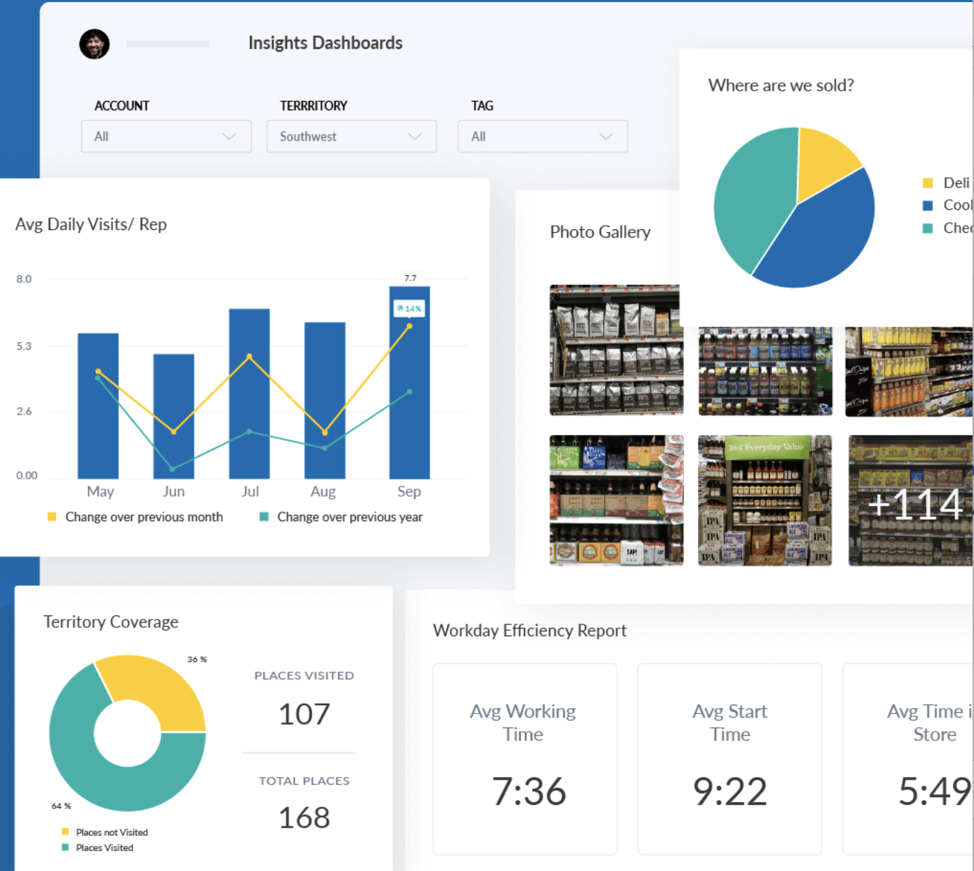
Repsly
Scheduling based on store visits and routes and scheduling
Typically used for stocking at stores, demos, etc.
Add locations - load the location with just a name w/out full address
Representatives - add in the field team members and you can have a monthly schedule
Drag and drop scheduling feature on the calendar– can change the dates easily
Alert sent to account manager if its not completed via email
Can save as a draft throughout the event and can work offline
Tag photo feature, allows clients to log in and see photos via hashtag
COST: $28,500 / 50 users (25k per year; $3,500 for initial set up)

Slide 25
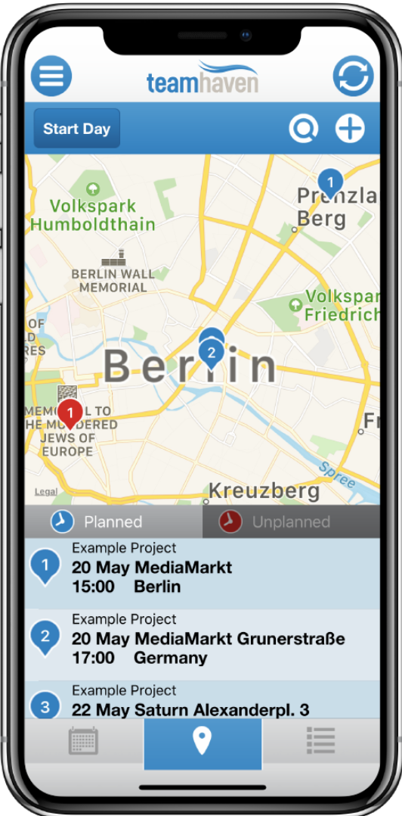
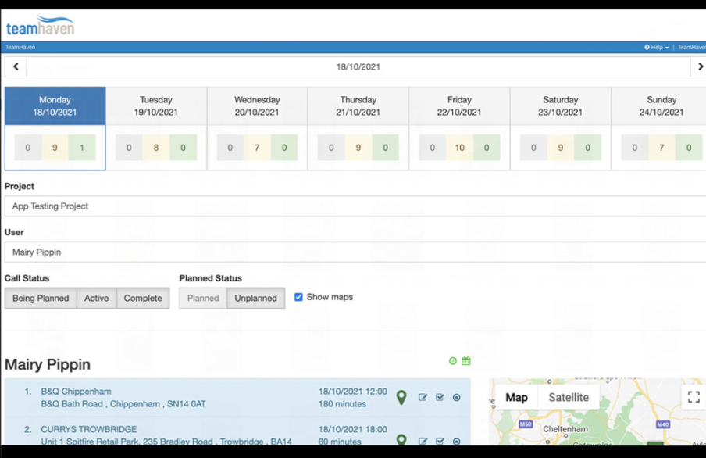
Teamhaven
In house software built for a field marketing agencies
Mobile app, just for the data collection, works offline
Web version is for admins and setting up the events
Very very old school UI
Design the survey unique to each tour
Geofencing check in
Can integrate with PowerBI
Two methods of getting data into PowerBi
Lock people by certain geographic/agencies
ISO certified, GDPR compliant
Push notifications daily for reminders
COST: Dependent on usage.
Billing based on actual events executed, not by users and no setup fee
Designed so you can build the cost of the software into the project costs

Slide 26
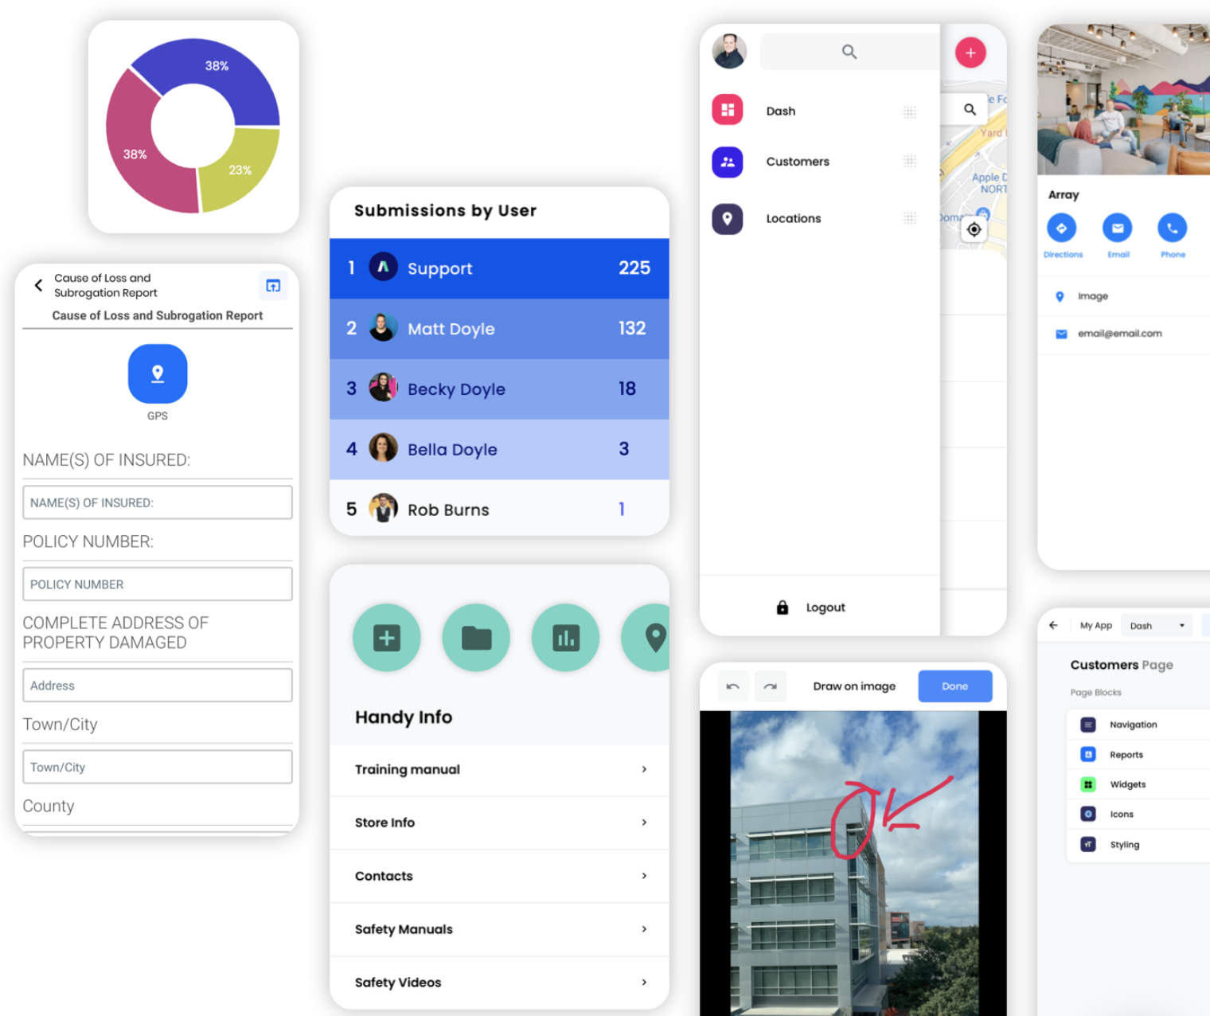
Array
Array’s mobile forms let you collect information from any
location quickly, easily and securely. With smart automation
and offline functionality
BA Assignments
IOS App
Signature forms and build your own recaps/surveys/etc
Pricing: TBD, they are able to do monthly pricing

Slide 27
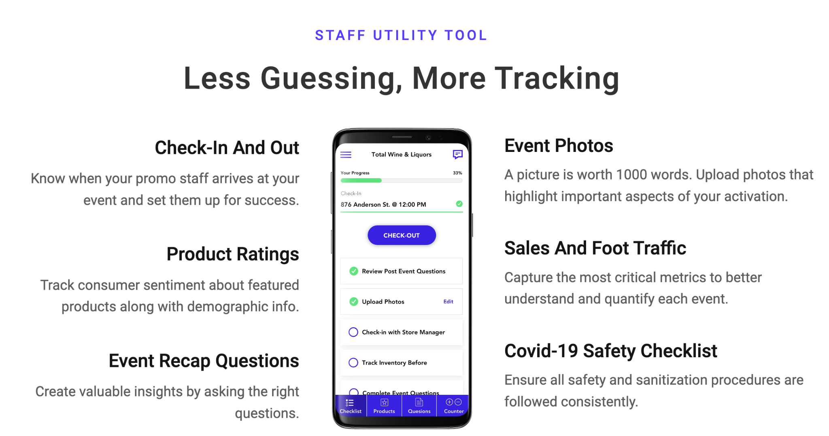
Samppoll
Could build something custom for $50k
They previously built out their software for field marketing, however closed it in 2020. They have all the functionality we are looking for, would just require the 50k to start it up again, custom for Momentum
https://www.sampoll.co/recapp

Slide 28
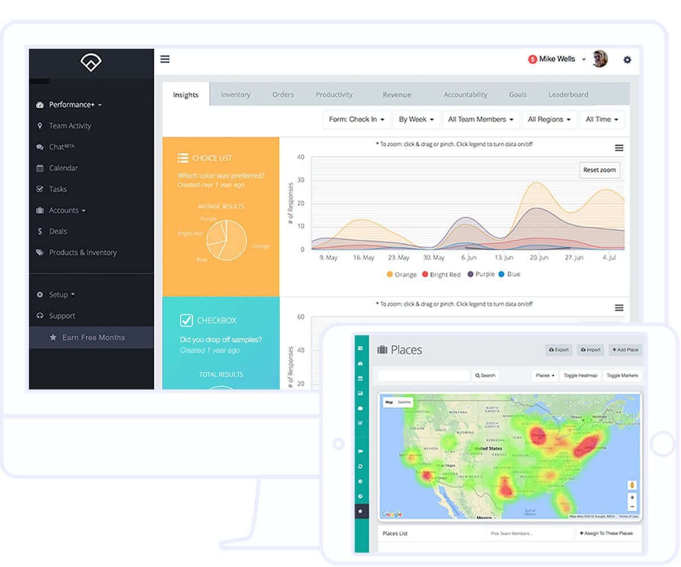
Outfield
https://www.outfieldapp.com/
We had a ton of convos with this company we really liked them however it is a big emphasis on field staff performance, rewarding people for check ins, recaps, etc. they have gamification specifically for field staff.
Features:
Bulk event uploads, mobile app for FMs, geolocation log in, custom recaps
**They are very very pushy and salesy
Pricing: 1 month - 69.99 per user per month; $59.99 /6 months; price is adjustable per program/length

Slide 29
CPG Vision
TBD demo
https://www.cpgvision.com

Slide 30
GUID System >> | Event is created GUID application must generate Parent ID and Event ID | FM Platform looks for GUID | FM Platform sends: Event Scheduling, Event Recap + GUID to MOMO BI
FM Platform>> | Event is created Application requires Event Name, Client, and Date

